Slide 1
CHAPTER:06, Counting
Suppose that a password on a computer system consists of six, seven, or eight characters. Each of these characters must be a digit or a letter of the alphabet. Each password must contain at least one digit. How many such passwords are there? The techniques needed to answer this question and a wide variety of other counting problems will be introduced in this Chapter.
Counting problems arise throughout mathematics and computer science. For example, we must count the successful outcomes of experiments and all the possible outcomes of these experiments to determine probabilities of discrete events. We need to count the number of operations used by an algorithm to study its time complexity.
FREE: For Complete Playlist: https://www.youtube.com/c/FahadHussaintutorial/playlists
For Code, Slide and Books: https://fahadhussaincs.blogspot.com/

Slide 2
6.1 The Basics of Counting
Basic Counting Principles: The Sum Rule
The Sum Rule: If a task can be done either in one of n₁ ways or in one of n₂ ways to do the second task, where none of the set of n₁ ways is the same as any of the n₂ ways, then there are n₁ + n₂ ways to do the task.
Sum Rule in terms of sets
The sum rule can be phrased in terms of sets.
|A 𝖴 B|= |A| + |B| as long as A and B are disjoint sets.
Or more generally,
|A₁ 𝖴 A₂ 𝖴 ∙∙∙ 𝖴 A_{m} |= |A₁| + |A₂| + ∙∙∙ + |A_{m}|
when A_{i} ∩ A_{j} = ∅ for all i, j.
FREE: For Complete Playlist: https://www.youtube.com/c/FahadHussaintutorial/playlists
For Code, Slide and Books: https://fahadhussaincs.blogspot.com/

Slide 3
Basic Counting Principles: The Sum Rule
Example:
Suppose there are 7 different optional courses in Computer Science and 3 different optional courses in Mathematics. How many ways student can choose a course.
Solution:
By the sum rule it follows that there are 7 + 3 = 10 choices for a student who wants to take one optional course.
FREE: For Complete Playlist: https://www.youtube.com/c/FahadHussaintutorial/playlists
For Code, Slide and Books: https://fahadhussaincs.blogspot.com/

Slide 4
Basic Counting Principles: The Sum Rule
Example: The mathematics department must choose either a student or a faculty member as a representative for a university committee. How many choices are there for this representative if there are 37 members of the mathematics faculty and 83 mathematics majors and no one is both a faculty member and a student.
Solution: By the sum rule it follows that there are
37 + 83 = 120 possible ways to pick a representative.

Slide 5
Basic Counting Principles: The Sum Rule
Example: A student can choose a computer project from one of the three lists. The three lists contain 23, 15 and 19 possible projects, respectively. How many possible projects are there to choose from?
Solution: The student can choose a project from the first list in 23 ways, from the second list in 15 ways, and from the third list in 19 ways. Hence, there are
23 + 15 + 19 = 57 projects to choose from.
FREE: For Complete Playlist: https://www.youtube.com/c/FahadHussaintutorial/playlists
For Code, Slide and Books: https://fahadhussaincs.blogspot.com/

Slide 6
Basic Counting Principles: The Product Rule
The Product Rule: A procedure can be broken down into a sequence of two tasks. There are n₁ ways to do the first task and n₂ ways to do the second task. Then there are n₁∙n₂ ways to do the procedure.
Product Rule in Terms of Sets
If A₁, A₂, … , A_{m} are finite sets, then the number of elements in the Cartesian product of these sets is the product of the number of elements of each set.
The task of choosing an element in the Cartesian product A₁ ⨉ A₂ ⨉ ∙∙∙ ⨉ A_{m} is done by choosing an element in A₁, an element in A₂ , …, and an element in A_{m}.
By the product rule, it follows that:
|A₁ ⨉ A₂ ⨉ ∙∙∙ ⨉ A_{m} |= |A₁| ∙ |A₂| ∙ ∙∙∙ ∙ |A_{m}|.
FREE: For Complete Playlist: https://www.youtube.com/c/FahadHussaintutorial/playlists
For Code, Slide and Books: https://fahadhussaincs.blogspot.com/

Slide 7
The Product Rule
Example: How many ways a student can choose one optional course each from computer science and mathematics courses if there are 7 different optional courses in Computer Science and 3 different optional courses in Mathematics.
Solution:
A student who wants to take one optional course of each subject, there are 7 × 3 = 21 choices.
FREE: For Complete Playlist: https://www.youtube.com/c/FahadHussaintutorial/playlists
For Code, Slide and Books: https://fahadhussaincs.blogspot.com/

Slide 8
The Product Rule
Example: The chairs of an auditorium are to be labeled with two characters, a letter followed by a digit. What is the largest number of chairs that can be labeled differently?
Solution:
The procedure of labeling a chair consists of two events, namely,
Assigning one of the 26 letters: A, B, C, …, Z and Assigning one of the 10 digits: 0, 1, 2, …, 9
By product rule, there are 26 × 10 = 260 different ways that a chair can be labeled by both a letter and a digit.
FREE: For Complete Playlist: https://www.youtube.com/c/FahadHussaintutorial/playlists
For Code, Slide and Books: https://fahadhussaincs.blogspot.com/

Slide 9
The Product Rule
Example: Find the number n of ways that an organization consisting of 15 members can elect a president, treasurer, and secretary. (assuming no person is elected to more than one position)
Solution:
The president can be elected in 15 different ways; following this, the treasurer can be elected in 14 different ways; and following this, the secretary can be elected in 13 different ways. Thus, by product rule, there are
n = 15 × 14 × 13 = 2730
different ways in which the organization can elect the officers.
FREE: For Complete Playlist: https://www.youtube.com/c/FahadHussaintutorial/playlists
For Code, Slide and Books: https://fahadhussaincs.blogspot.com/

Slide 10
The Product Rule
Example: There are four bus lines between A and B; and three bus lines between B and C.
Find the number of ways a person can travel:
By bus from A to C by way of B;
Round trip by bus from A to C by way of B;
Round trip by bus from A to C by way of B, if the person does not want to use a bus line more than once.
FREE: For Complete Playlist: https://www.youtube.com/c/FahadHussaintutorial/playlists
For Code, Slide and Books: https://fahadhussaincs.blogspot.com/

Slide 11
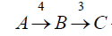
The Product Rule
a) By bus from A to C by way of B; Solution:
There are 4 ways to go from A to B and 3 ways to go from B to C; hence there are 4 × 3 = 12 ways to go from A to C by way of B.
FREE: For Complete Playlist: https://www.youtube.com/c/FahadHussaintutorial/playlists
For Code, Slide and Books: https://fahadhussaincs.blogspot.com/

Slide 12
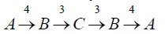
The Product Rule
b) Round trip by bus from A to C by way of B;
Solution:
The person will travel from A to B to C to B to A for the round trip. i.e. (A →B →C →B →A)
The person can travel 4 ways from A to B and 3 way from B to C and back.
Thus there are 4 ×3 ×3 × 4 = 144 ways to travel the round trip.
FREE: For Complete Playlist: https://www.youtube.com/c/FahadHussaintutorial/playlists
For Code, Slide and Books: https://fahadhussaincs.blogspot.com/

Slide 13
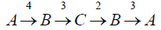
The Product Rule
c) Round trip by bus from A to C by way of B, if the person does not want to use a bus line more than once.
Solution:
The person can travel 4 ways from A to B and 3 ways from B to C, but only 2 ways from C to B and 3 ways from B to A, since bus line cannot be used more than once. Hence there are
4 ×3 ×2 × 3 = 72 ways
to travel the round trip without using a bus line more than once.
FREE: For Complete Playlist: https://www.youtube.com/c/FahadHussaintutorial/playlists
For Code, Slide and Books: https://fahadhussaincs.blogspot.com/

Slide 14
The Product Rule
Example: A bit string is a sequence of 0’s and 1’s.How many bit string are there of length 4?
Solution:
Each bit (binary digit) is either 0 or 1.
Hence, there are 2 ways to choose each bit. Since we have to choose four bits therefore,
the product rule shows, there are a total of different bit strings of length four.
FREE: For Complete Playlist: https://www.youtube.com/c/FahadHussaintutorial/playlists
For Code, Slide and Books: https://fahadhussaincs.blogspot.com/

Slide 15
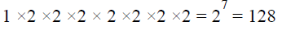
The Product Rule
Example: How many bit strings of length 8: (i ) begin with a 1?
(ii) begin and end with a 1?
Solution:
(i) If the first bit (left most bit) is a 1, then it can be filled in only one way. Each of the remaining seven positions in the bit string can be filled in 2 ways (i.e., either by 0 or 1). Hence, there are
different bit strings of length 8 that begin with a 1.
FREE: For Complete Playlist: https://www.youtube.com/c/FahadHussaintutorial/playlists
For Code, Slide and Books: https://fahadhussaincs.blogspot.com/

Slide 16
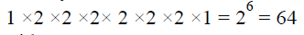
The Product Rule
(ii) begin and end with a 1?
Solution:
If the first and last bit in an 8 bit string is a 1, then only the intermediate six bits can be filled in 2 ways, i.e. by a 0 or 1.
Hence there are
different bit strings of length 8 that begin and end with a 1.
FREE: For Complete Playlist: https://www.youtube.com/c/FahadHussaintutorial/playlists
For Code, Slide and Books: https://fahadhussaincs.blogspot.com/

Slide 17
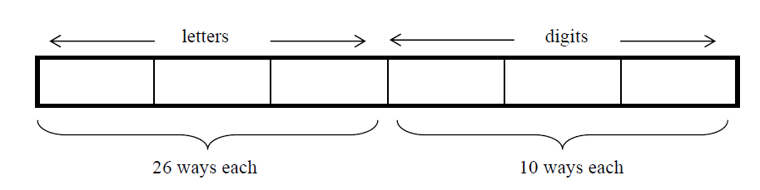
The Product Rule
Example: Suppose that an automobile license plate has three letters followed by three digits.
(a) How many different license plates are possible?
Solution:
Each of the three letters can be written in 26 different ways, and each of the three digits can be written in 10 different ways.
Hence, by the product rule, there is a total of
26 × 26 × 26 × 10 × 10 × 10 = 17,576,000
different License plates possible.
FREE: For Complete Playlist: https://www.youtube.com/c/FahadHussaintutorial/playlists
For Code, Slide and Books: https://fahadhussaincs.blogspot.com/

Slide 18
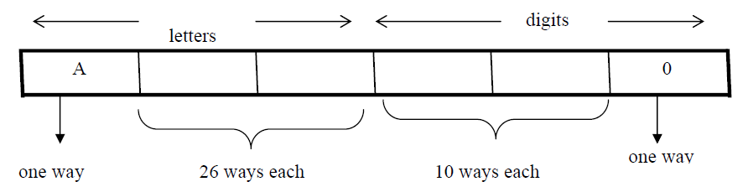
The Product Rule
(b) How many license plates could begin with A and end on 0?
Solution:
The first and last place can be filled in one way only, while each of second and third place can be filled in 26 ways and each of fourth and fifth place can be filled in 10 ways.
Number of license plates that begin with A and end in 0 are
1 × 26 × 26 × 10 × 10 × 1 = 67600
FREE: For Complete Playlist: https://www.youtube.com/c/FahadHussaintutorial/playlists
For Code, Slide and Books: https://fahadhussaincs.blogspot.com/

Slide 19
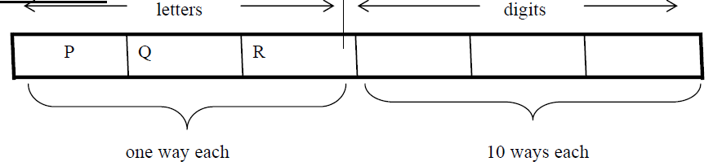
The Product Rule
(c) How many license plates begin with PQR.
Solution:
Number of license plates that begin with PQR are
1 × 1 × 1 × 10 × 10 × 10 = 1000 ways.
FREE: For Complete Playlist: https://www.youtube.com/c/FahadHussaintutorial/playlists
For Code, Slide and Books: https://fahadhussaincs.blogspot.com/

Slide 20
The Product Rule
(d) How many license plates are possible in which all the letters and digits are distinct?
Solution:
The first letter place can be filled in 26 ways. Since, the second letter place should contain a different letter than the first, so it can be filled in 25 ways. Similarly, the third letter place can be filled in 24 ways. And the digits can be respectively filled in 10, 9, and 8 ways.
Hence;
number of license plates in which all the letters and digits are distinct are
26 × 25 × 24 × 10 × 9 × 8 = 11, 232, 000
FREE: For Complete Playlist: https://www.youtube.com/c/FahadHussaintutorial/playlists
For Code, Slide and Books: https://fahadhussaincs.blogspot.com/

Slide 21
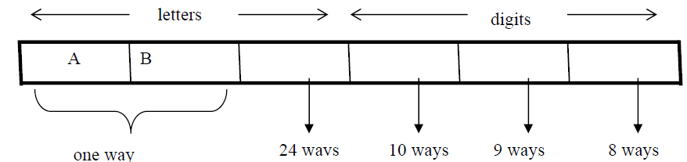
The Product Rule
(e) How many license plates could begin with AB and
three letters and digits distinct.
Solution:
have all
The first two letters places are fixed (to be filled with A and B), so there is only one way to fill them. The third letter place should contain a letter different from A & B, so there
are 24 ways to fill it.
The three digit positions can be filled in 10 and 8 ways to have distinct digits. Hence, desired number of license plates are
1 × 1 × 24 × 10 × 9 × 8 = 17280
FREE: For Complete Playlist: https://www.youtube.com/c/FahadHussaintutorial/playlists
For Code, Slide and Books: https://fahadhussaincs.blogspot.com/

Slide 22
Telephone Numbering Plan
Example: The North American numbering plan (NANP) specifies that a telephone number consists of 10 digits, consisting of a three-digit area code, a three-digit office code, and a four-digit station code. There are some restrictions on the digits.
Let X denote a digit from 0 through 9.
Let N denote a digit from 2 through 9.
Let Y denote a digit that is 0 or 1.
In the old plan (in use in the 1960s) the format was NYX-NNX-XXXX.
In the new plan, the format is NXX-NXX-XXXX.
How many different telephone numbers are possible under the old plan and the new plan?
Solution: Use the Product Rule.
There are 8 ∙2 ∙10 = 160 area codes with the format NYX.
There are 8 ∙10 ∙10 = 800 area codes with the format NXX.
There are 8 ∙8 ∙10 = 640 office codes with the format NNX.
There are 10 ∙10 ∙10 ∙10 = 10,000 station codes with the format XXXX. Number of old plan telephone numbers: 160 ∙640 ∙10,000 = 1,024,000,000. Number of new plan telephone numbers: 800 ∙800 ∙10,000 = 6,400,000,000.

Slide 23
NUMBER OF ITERATIONS OF A NESTED LOOP
Example: Determine how many times the inner loop will be
iterated
when the following algorithm is implemented and run For i: = 1 to 4
For j : = 1 to 3
[Statement in body of inner loop. None contain branching statements that lead out of the inner loop.]
next j
next i
Solution:
The outer loop is iterated four times, and during each iteration of
the outer loop, there are three iterations of the inner loop.
Hence, by product rules the total number of iterations of inner loop is 4·3=12

Slide 24
Example: Determine how many times the inner loop will be iterated when the following algorithm is implemented and run.
for i = 5 to 50
for j: = 10 to 20
[Statement in body of inner loop. None contain branching statements that lead out of the inner loop.]
next j next i
Solution:
The outer loop is iterated 50 - 5 + 1 = 46 times and during each iteration of the outer loop there are 20 - 10 + 1 = 11 iterations of the inner loop. Hence by product rule, the total number of iterations of the inner loop is 46×11 = 506.

Slide 25
Example: Determine how many times the inner loop will be iterated when the following algorithm is implemented and run.
for i: = 1 to 4
for j: = 1 to i
[Statements in body of inner loop. None contain branching statements that lead outside the loop.]
next j next i
Solution:
The outer loop is iterated 4 times, but during each iteration of the outer loop, the inner loop iterates different number of times.
For first iteration of outer loop, inner loop iterates 1 times. For second iteration of outer loop, inner loop iterates 2 times.
For third iteration of outer loop, inner loop iterates 3 times.
For fourth iteration of outer loop, inner loop iterates 4 times. Hence, total number of iterations of inner loop = 1 + 2 + 3 + 4 = 10.

Slide 26
Combining the Sum and Product Rule
Example: Suppose statement labels in a programming language can be either a single letter or a letter followed by a digit. Find the number of possible labels.
Solution:
First consider variable names one character in length. Since such names consist of a single letter, there are 26 variable names of length 1.
Next, consider variable names two characters in length. Since the first character is a letter, there are 26 ways to choose it. The second character is a digit, there are 10 ways to choose it. Hence, to construct variable name of two characters in length, there are 26×10 = 260 ways.
Finally, by sum rule, there are 26 + 260 = 286 possible variable names in the programming language.

Slide 27
Combining the Sum and Product Rule
Example: A computer access code word consists of from one to three letters of English alphabets with repetitions allowed. How many different code words are possible.
Solution:
Number of code words of length 1 = 26¹ Number of code words of length 2 = 26² Number of code words of length 3 = 26³ Hence, the total number of code words =
26¹+ 26² + 26³= 18,278
FREE: For Complete Playlist: https://www.youtube.com/c/FahadHussaintutorial/playlists
For Code, Slide and Books: https://fahadhussaincs.blogspot.com/

Slide 28
Counting Passwords
Combining the sum and product rule allows us to solve more complex problems.
Example: Each user on a computer system has a password, which is six to eight characters long, where each character is an uppercase letter or a digit. Each password must contain at least one digit. How many possible passwords are there?
Solution: Let P be the total number of passwords, and let P₆, P₇, and P₈
be the passwords of length 6, 7, and 8.
By the sum rule P = P₆ + P₇ +P₈.
Finding P₆ directly is difficult. To find P₆ it is easier to find the number of strings of uppercase letters and digits that are six characters long, including those with no digits, and subtract from this the number of strings with no digits. By the product rule, the number of strings of six characters is 36⁶ ,and the number of strings with no digits is 26⁶
FREE: For Complete Playlist: https://www.youtube.com/c/FahadHussaintutorial/playlists
For Code, Slide and Books: https://fahadhussaincs.blogspot.com/

Slide 29
Counting Passwords(Continued)
To find each of P6, P7, and P8 , we find the number of passwords of the specified length composed of letters and digits and subtract the number composed only of letters. We find that:
P₆ = 36⁶ − 26⁶ = 2,176,782,336 − 308,915,776 =1,867,866,560.
P₇ = 36⁷ − 26⁷ = 78,364,164,096 − 8,031,810,176 = 70,332,353,920.
P₈ = 36⁸ − 26⁸ = 2,821,109,907,456 − 208,827,064,576 =2,612,282,842,880.
Consequently, P = P₆ + P₇ + P₈ = 2,684,483,063,360.
FREE: For Complete Playlist: https://www.youtube.com/c/FahadHussaintutorial/playlists
For Code, Slide and Books: https://fahadhussaincs.blogspot.com/

Slide 30
Basic Counting Principles: Subtraction Rule
Subtraction Rule: If a task can be done either in one of n₁ ways or in one of n₂ ways, then the total number of ways to do the task is n₁ + n₂ minus the number of ways to do the task that are common to the two different ways.
Also known as, the principle of inclusion-exclusion:
FREE: For Complete Playlist: https://www.youtube.com/c/FahadHussaintutorial/playlists
For Code, Slide and Books: https://fahadhussaincs.blogspot.com/

Slide 31
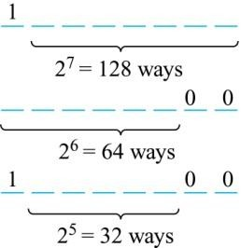
Counting Bit Strings
Example: How many bit strings of length eight start either with a 1 bit or end with the two bits 00?
Solution: Use the subtraction rule.
Number of bit strings of length eight that start with a 1 bit: 2⁷ = 128
Number of bit strings of length eight that end with bits 00: 2⁶ = 64
Number of bit strings of length eight
that start with a 1 bit and end with bits 00 : 2⁵ = 32
Hence, the number is 128 + 64 − 32 = 160.
FREE: For Complete Playlist: https://www.youtube.com/c/FahadHussaintutorial/playlists
For Code, Slide and Books: https://fahadhussaincs.blogspot.com/

Slide 32
Counting Functions
Counting Functions: How many functions are there from a
set with m elements to a set with n elements?
Solution: Since a function represents a choice of one of the n elements of the codomain for each of the m elements in the domain, the product rule tells us that there are n ∙ n ∙ ∙ ∙ n = n^{m} such functions.
Counting One-to-One Functions: How many one-to-one functions are there from a set with m elements to one with n elements?
Solution: Suppose the elements in the domain are a₁, a₂,…, a_{m}. There are n ways to choose the value of a₁ and n−1 ways to choose a₂, etc. The product rule tells us that there are n(n−1) (n−2)∙∙∙(n−m +1) such functions.
FREE: For Complete Playlist: https://www.youtube.com/c/FahadHussaintutorial/playlists
For Code, Slide and Books: https://fahadhussaincs.blogspot.com/

Slide 33
Tree Diagrams
Tree Diagrams: We can solve many counting problems through the use of tree diagrams, where a branch represents a possible choice and the leaves represent possible outcomes.
Example: Suppose that “I Love Discrete Math” T-shirts come in five different sizes: S,M,L,XL, and XXL. Each size comes in four colors (white, red, green, and black), except XL, which comes only in red, green, and black, and XXL, which comes only in green and black. What is the minimum number of shirts that the campus book store needs to stock to have one of each size and color available?
FREE: For Complete Playlist: https://www.youtube.com/c/FahadHussaintutorial/playlists
For Code, Slide and Books: https://fahadhussaincs.blogspot.com/

Slide 34
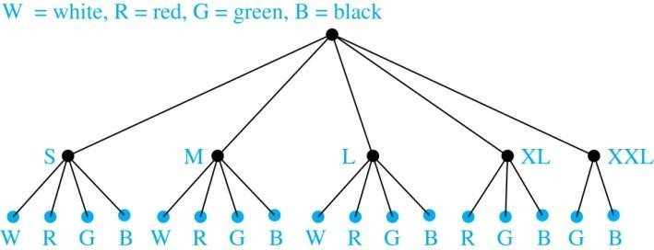
Tree Diagrams
Solution: Draw the tree diagram.
The store must stock 17 T-shirts.

Slide 35
6.2 The Pigeonhole Principle
Pigeonhole Principle: If k is a positive integer and k + 1 objects are placed into k boxes, then at least one box contains two or more objects.
Proof: We use a proof by contraposition. Suppose none of the k boxes has more than one object. Then the total number of objects would be at most k. This contradicts the statement that we have k + 1 objects.
FREE: For Complete Playlist: https://www.youtube.com/c/FahadHussaintutorial/playlists
For Code, Slide and Books: https://fahadhussaincs.blogspot.com/

Slide 36
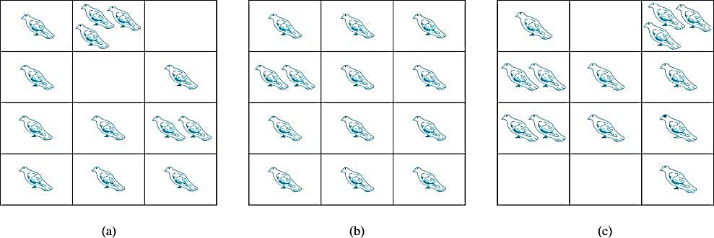

The Pigeonhole Principle
If a flock of 20 pigeons roosts in a set of 19 pigeonholes, one of the pigeonholes must have more than 1 pigeon.
FREE: For Complete Playlist: https://www.youtube.com/c/FahadHussaintutorial/playlists
For Code, Slide and Books: https://fahadhussaincs.blogspot.com/

Slide 37
The Pigeonhole Principle
Corollary 1: A function f from a set with k + 1
elements to a set with k elements is not one-to-one.
Proof: Use the pigeonhole principle.
Create a box for each element y in the codomain of f .
Put in the box for y all of the elements x from the
domain such that f(x) = y.
Because there are k + 1 elements and only k boxes, at least one box has two or more elements.
Hence, f can’t be one-to-one.
FREE: For Complete Playlist: https://www.youtube.com/c/FahadHussaintutorial/playlists
For Code, Slide and Books: https://fahadhussaincs.blogspot.com/

Slide 38
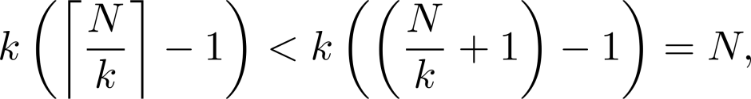
The Generalized Pigeonhole Principle
The Generalized Pigeonhole Principle:
If N objects are placed into k boxes, then there is at least one box containing at least ⌈N/k⌉ objects.
Proof: We use a proof by contraposition. Suppose that none of the boxes contains more than ⌈N/k⌉ − 1 objects.
Then the total number of objects is at most
where the inequality ⌈N/k⌉ < ⌈N/k⌉ + 1 has been used. This is a contradiction because there are a total of n objects.
FREE: For Complete Playlist: https://www.youtube.com/c/FahadHussaintutorial/playlists
For Code, Slide and Books: https://fahadhussaincs.blogspot.com/

Slide 39
Pigeonhole Principle
Example: Among any group of 367 people, there must be at least two with the same birthday, because there are only 366 possible birthdays. ⌈367/366⌉ = 2
Example: Among 100 people there are at least
⌈100/12⌉ = 9 who were born in the same month.
Example: In any set of 27 English , must be at least two that begin with the same letter, since there are 26 letters in the English alphabet. ⌈27/26⌉ = 2
FREE: For Complete Playlist: https://www.youtube.com/c/FahadHussaintutorial/playlists
For Code, Slide and Books: https://fahadhussaincs.blogspot.com/

Slide 40
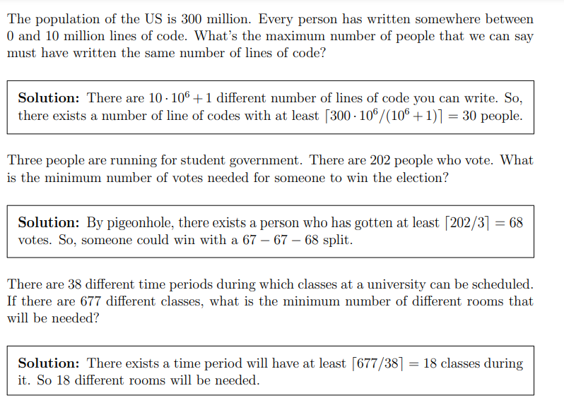
Pigeonhole Principle
FREE: For Complete Playlist: https://www.youtube.com/c/FahadHussaintutorial/playlists
For Code, Slide and Books: https://fahadhussaincs.blogspot.com/

Slide 41
The Generalized Pigeonhole Principle
Example: What is the minimum number of students required in a Discrete Mathematics class to be sure that at least six will receive the same grade, if there are five possible grades, A, B, C, D, and F.
Solution:
The minimum number of students needed to guarantee that at least six students receive the same grade is the smallest integer N such that ⌈ N/K ⌉ = ⌈ N/5 ⌉ = 6. The smallest such integer is
N = K(⌈ N/K ⌉-1)+1 = 5(6-1)+1=5 ⋅ 5 + 1 = 26.
Thus 26 is the minimum number of students needed to be sure that at least 6 students will receive the same grades.
FREE: For Complete Playlist: https://www.youtube.com/c/FahadHussaintutorial/playlists
For Code, Slide and Books: https://fahadhussaincs.blogspot.com/

Slide 42
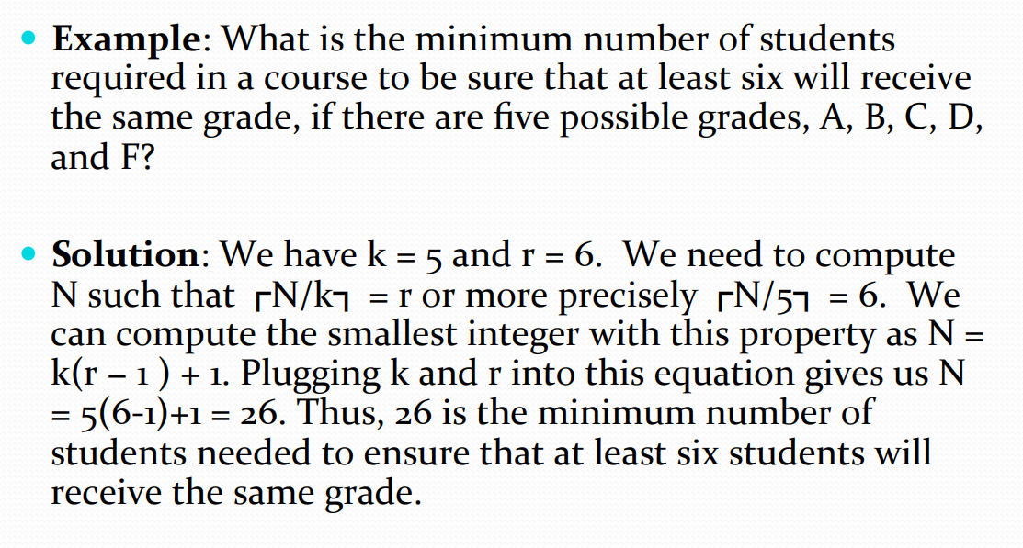
The Generalized Pigeonhole Principle
FREE: For Complete Playlist: https://www.youtube.com/c/FahadHussaintutorial/playlists
For Code, Slide and Books: https://fahadhussaincs.blogspot.com/

Slide 43
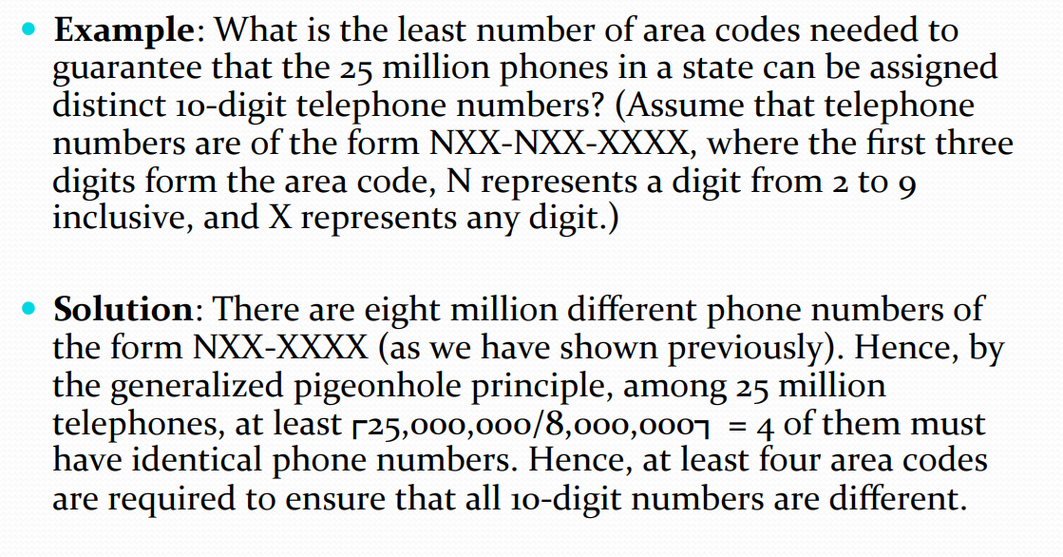
The Generalized Pigeonhole Principle
FREE: For Complete Playlist: https://www.youtube.com/c/FahadHussaintutorial/playlists
For Code, Slide and Books: https://fahadhussaincs.blogspot.com/

Slide 44
6.3 Permutations and Combinations
Permutations
Definition: A permutation of a set of distinct objects is an ordered arrangement of these objects. An ordered arrangement of r elements of a set is called an r-permutation.
Example: Let S = {1,2,3}.
The ordered arrangement 3,1,2 is a permutation of S.
The ordered arrangement 3,2 is a 2-permutation of S.
The number of r-permutations of a set with n
elements is denoted by P(n,r).
The 2-permutations of S = {1,2,3} are 1,2; 1,3; 2,1; 2,3;
3,1; and 3,2. Hence, P(3,2) = 6.
FREE: For Complete Playlist: https://www.youtube.com/c/FahadHussaintutorial/playlists
For Code, Slide and Books: https://fahadhussaincs.blogspot.com/

Slide 45
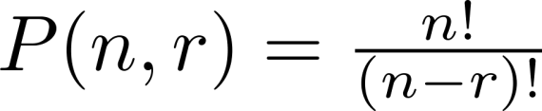
A Formula for the Number of Permutations
Theorem 1: If n is a positive integer and r is an integer with
1 ≤ r ≤ n, then there are
P(n, r) = n(n − 1)(n − 2) ∙∙∙ (n − r + 1)
r-permutations of a set with n distinct elements.
Proof: Use the product rule. The first element can be chosen in n
ways. The second in n − 1 ways, and so on until there are
(n − ( r − 1)) ways to choose the last element.
Note that P(n,0) = 1, since there is only one way to order zero elements.
Corollary 1: If n and r are integers with 1 ≤ r ≤ n, then
FREE: For Complete Playlist: https://www.youtube.com/c/FahadHussaintutorial/playlists
For Code, Slide and Books: https://fahadhussaincs.blogspot.com/

Slide 46
Solving Counting Problems by Counting Permutations
Example: How many ways are there to select a first- prize winner, a second prize winner, and a third-prize winner from 100 different people who have entered a contest?
Solution:
P(100,3) = 100 ∙ 99 ∙ 98 = 970,200
FREE: For Complete Playlist: https://www.youtube.com/c/FahadHussaintutorial/playlists
For Code, Slide and Books: https://fahadhussaincs.blogspot.com/

Slide 47
Solving Counting Problems by Counting Permutations (continued)
Example: Suppose that there are eight runners in a race. The winner receives a gold medal, the second place finisher receives a silver medal, and the third-place finisher receives a bronze medal. How many different ways are there to award these medals, if all possible outcomes of the race can occur and there are no ties?
Solution: The number of different ways to award the medals is the number of 3-permutations of a set with eight elements. Hence, there are
P(8, 3) = 8 · 7 · 6 = 336
possible ways to award the medals.
FREE: For Complete Playlist: https://www.youtube.com/c/FahadHussaintutorial/playlists
For Code, Slide and Books: https://fahadhussaincs.blogspot.com/

Slide 48
Solving Counting Problems by Counting Permutations (continued)
Example: Suppose that a saleswoman has to visit eight different cities. She must begin her trip in a specified city, but she can visit the other seven cities in any order she wishes. How many possible orders can the saleswoman use when visiting these cities?
Solution: The first city is chosen, and the rest are ordered arbitrarily. Hence the orders are:
P(7,7)= 7! = 7 ∙ 6 ∙ 5 ∙ 4 ∙ 3 ∙ 2 ∙ 1 = 5040
If she wants to find the tour with the shortest path that visits all the cities, she must consider 5040 paths!
FREE: For Complete Playlist: https://www.youtube.com/c/FahadHussaintutorial/playlists
For Code, Slide and Books: https://fahadhussaincs.blogspot.com/

Slide 49
Solving Counting Problems by Counting Permutations (continued)
Example: How many permutations of the letters
ABCDEFGH contain the string ABC ?
Solution: We solve this problem by counting the permutations of six objects, ABC, D, E, F, G, and H.
P(6,6)= 6! = 6 ∙ 5 ∙ 4 ∙ 3 ∙ 2 ∙ 1 = 720
FREE: For Complete Playlist: https://www.youtube.com/c/FahadHussaintutorial/playlists
For Code, Slide and Books: https://fahadhussaincs.blogspot.com/

Slide 50
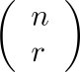
Combinations
Definition: An r-combination of elements of a set is an unordered selection of r elements from the set.
Thus, an r-combination is simply a subset of the set with r elements.
The number of r-combinations of a set with n distinct elements is denoted by C(n, r).
The notation is also used and is called a binomial coefficient. (We will see the notation again in the binomial theorem in Section. 6.4)
FREE: For Complete Playlist: https://www.youtube.com/c/FahadHussaintutorial/playlists
For Code, Slide and Books: https://fahadhussaincs.blogspot.com/

Slide 51
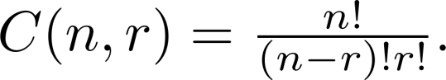
Combinations
Example:
Let S be the set {a, b, c, d}. Then {a, c, d} is a 3- combination from S. It is the same as {d, c, a} since the order listed does not matter.
C(4,2) = 6 because the 2-combinations of {a, b, c, d} are the six subsets {a, b}, {a, c}, {a, d}, {b, c}, {b, d}, and {c, d}.
Theorem 2: The number of r-combinations of a set with n elements, where n ≥ r ≥ 0, equals
Proof: By the product rule P(n, r) = C(n,r) ∙ P(r,r). Therefore,
FREE: For Complete Playlist: https://www.youtube.com/c/FahadHussaintutorial/playlists
For Code, Slide and Books: https://fahadhussaincs.blogspot.com/

Slide 52
Combinations
Theorem 2: The number of r-combinations of a set with n elements, where n ≥ r ≥ 0, equals
Proof: By the product rule P(n, r) = C(n,r) ∙ P(r,r). Therefore,
FREE: For Complete Playlist: https://www.youtube.com/c/FahadHussaintutorial/playlists
For Code, Slide and Books: https://fahadhussaincs.blogspot.com/

Slide 53
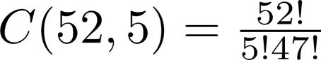
Combinations
Example: How many poker hands of five cards can be dealt from a standard deck of 52 cards? Also, how many ways are there to select 47 cards from a deck of 52 cards?
Solution: Since the order in which the cards are dealt does not matter, the number of five card hands is:
The different ways to select 47 cards from 52 is
This is a special case of a general result. →
FREE: For Complete Playlist: https://www.youtube.com/c/FahadHussaintutorial/playlists
For Code, Slide and Books: https://fahadhussaincs.blogspot.com/

Slide 54
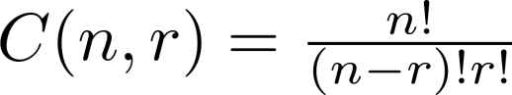
Combinations
Corollary 2: Let n and r be nonnegative integers with
r ≤ n. Then C(n, r) = C(n, n − r).
Proof: From Theorem 2, it follows that
and
Hence, C(n, r) = C(n, n − r).
This result can be proved without using algebraic manipulation. →
FREE: For Complete Playlist: https://www.youtube.com/c/FahadHussaintutorial/playlists
For Code, Slide and Books: https://fahadhussaincs.blogspot.com/

Slide 55
Combinatorial Proofs
Definition 1: A combinatorial proof of an identity is a proof that uses one of the following methods.
A double counting proof uses counting arguments to prove that both sides of an identity count the same objects, but in different ways.
A bijective proof shows that there is a bijection between the sets of objects counted by the two sides of the identity.
FREE: For Complete Playlist: https://www.youtube.com/c/FahadHussaintutorial/playlists
For Code, Slide and Books: https://fahadhussaincs.blogspot.com/

Slide 56
Combinatorial Proofs
Proof: We will use a bijective proof to show that C(n, r) = C(n, n − r) for all integers n and r with 0 ≤ r ≤ n. Suppose that S is a set with n elements. The function that maps a subset A of S to A` is a bijection between subsets of S with r elements and subsets with n − r elements (as the reader should verify).
The identity C(n, r) = C(n, n − r) follows because when there is a bijection between two finite sets, the two sets must have the same number of elements. Alternatively, we can reformulate this argument as a double counting proof.
By definition, the number of subsets of S with r elements equals C(n, r). But each subset A of S is also determined by specifying which elements are not in A, and so are in A`. Because the complement of a subset of S with r elements has n − r elements, there are also C(n, n − r) subsets of S with r elements. It follows that C(n, r) = C(n, n − r).
FREE: For Complete Playlist: https://www.youtube.com/c/FahadHussaintutorial/playlists
For Code, Slide and Books: https://fahadhussaincs.blogspot.com/

Slide 57
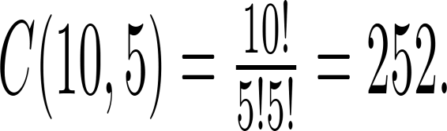
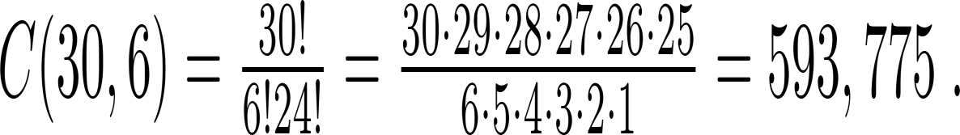
Combinations
Example: How many ways are there to select five players from a 10-member tennis team to make a trip to a match at another school.
Solution: By Theorem 2, the number of combinations is
Example: A group of 30 people have been trained as astronauts to go on the first mission to Mars. How many ways are there to select a crew of six people to go on this mission?
Solution: By Theorem 2, the number of possible crews is
FREE: For Complete Playlist: https://www.youtube.com/c/FahadHussaintutorial/playlists
For Code, Slide and Books: https://fahadhussaincs.blogspot.com/

Slide 58
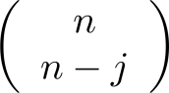
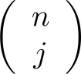
6.4 Binomial Coefficients and Identities
Binomial Theorem: Let x and y be variables, and n a nonnegative integer. Then:
Proof: We use combinatorial reasoning . The terms in the expansion of (x + y)^{n} are of the form x^{n−j}y^{j} for
j = 0,1,2,…,n. To form the term x^{n−j}y^{j}, it is necessary to choose n−j xs from the n sums. Therefore, the coefficient of x^{n−j}y^{j} is which equals .
FREE: For Complete Playlist: https://www.youtube.com/c/FahadHussaintutorial/playlists
For Code, Slide and Books: https://fahadhussaincs.blogspot.com/

Slide 59
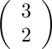
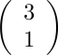
Powers of Binomial Expressions
Definition: A binomial expression is the sum of two terms, such as x + y. (More generally, these terms can be products of constants and variables.)
We can use counting principles to find the coefficients in the expansion of (x +
y)^{n} where n is a positive integer.
To illustrate this idea, we first look at the process of expanding (x + y)³.
(x + y) (x + y) (x + y) expands into a sum of terms that are the product of a term
from each of the three sums.
Terms of the form x³, x²y, x y², y³ arise. The question is what are the coefficients?
To obtain x³ , an x must be chosen from each of the sums. There is only one way to do this. So, the coefficient of x³ is 1.
To obtain x²y, an x must be chosen from two of the sums and a y from the other.
There are ways to do this and so the coefficient of x²y is 3.
To obtain xy², an x must be chosen from of the sums and a y from the other two . There are ways to do this and so the coefficient of xy² is 3.
To obtain y³ , a y must be chosen from each of the sums. There is only one way to do this. So, the coefficient of y³ is 1.
We have used a counting argument to show that (x + y)³ = x³ + 3x²y + 3x y² + y³ .
Next we present the binomial theorem gives the coefficients of the terms in the expansion of (x + y)^{n} .

Slide 60
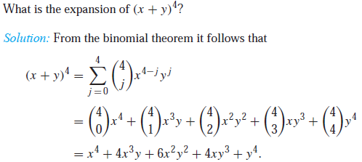
Using the Binomial Theorem
Example:
FREE: For Complete Playlist: https://www.youtube.com/c/FahadHussaintutorial/playlists
For Code, Slide and Books: https://fahadhussaincs.blogspot.com/

Slide 61
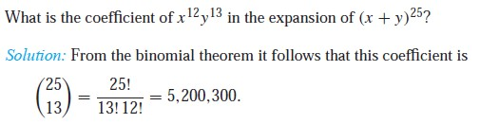
Using the Binomial Theorem
FREE: For Complete Playlist: https://www.youtube.com/c/FahadHussaintutorial/playlists
For Code, Slide and Books: https://fahadhussaincs.blogspot.com/

Slide 62
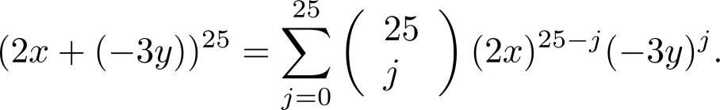
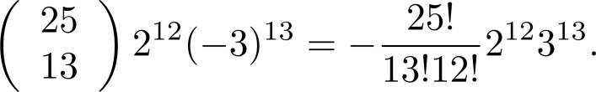
Using the Binomial Theorem
Example: What is the coefficient of x¹²y¹³ in the expansion of (2x − 3y)²⁵?
Solution: We view the expression as (2x +(−3y))²⁵. By the binomial theorem
Consequently, the coefficient of x¹²y¹³ in the expansion is obtained when j = 13.
FREE: For Complete Playlist: https://www.youtube.com/c/FahadHussaintutorial/playlists
For Code, Slide and Books: https://fahadhussaincs.blogspot.com/

Slide 63
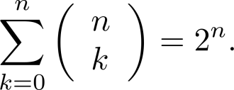
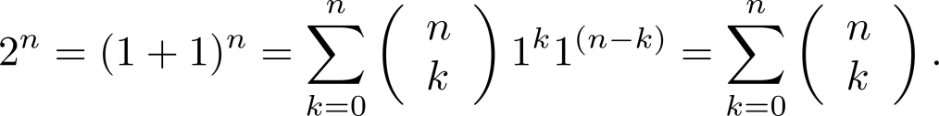
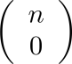
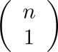
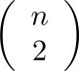
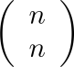
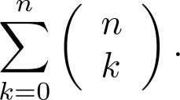
A Useful Identity
Corollary 1: With n ≥0,
Proof (using binomial theorem): With x = 1 and y = 1, from the
binomial theorem we see that:
Proof (combinatorial): Consider the subsets of a set with n elements. There are subsets with zero elements, with one element, with two elements, …, and with n elements.
Therefore the total is
Since, we know that a set with n elements has 2^{n} subsets, we conclude:

Slide 64
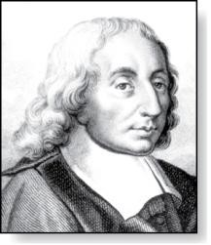
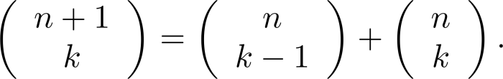
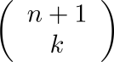
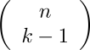
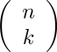
Pascal’s Identity
Pascal’s Identity: If n and k are integers with n ≥ k ≥ 0, then
Blaise Pascal
(1623-1662)
Proof (combinatorial): Let T be a set where |T| = n + 1, a ∊T, and
S = T − {a}. There are subsets of T containing k elements. Each of these subsets either:
contains a with k − 1 other elements, or
contains k elements of S and not a.
There are
⚫
subsets of k elements that contain a, since there are
subsets of k − 1 elements of S,
subsets of k elements of T that do not contain a, because there
are subsets of k elements of S.
See Exercise 19
for an algebraic proof.
Hence,

Slide 65
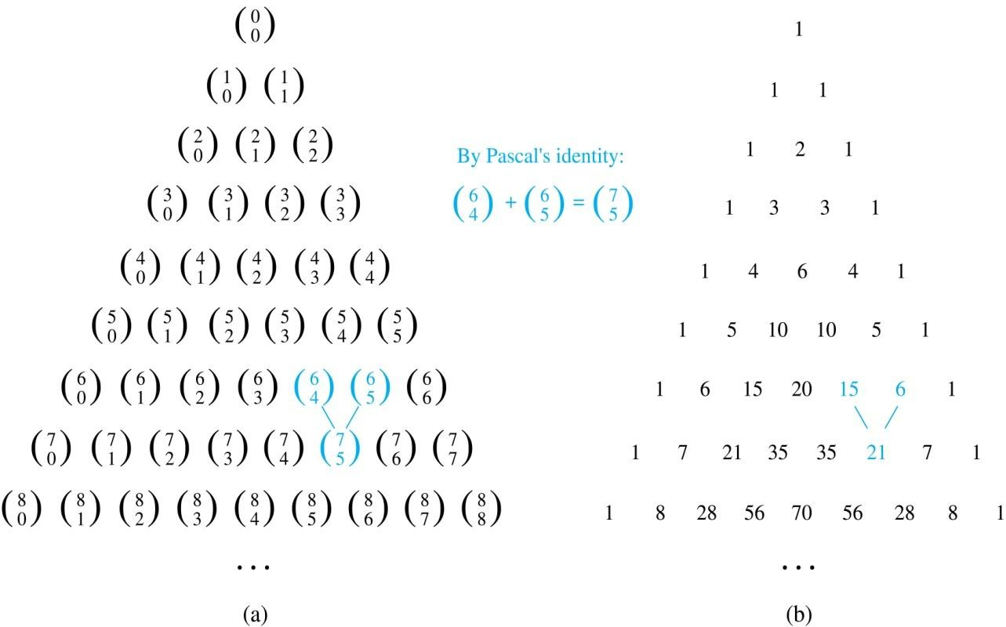
Pascal’s Triangle
The nth row in the triangle consists of the binomial coefficients , k = 0,1,….,n.
By Pascal’s identity, adding two adjacent bionomial coefficients results is the binomial coefficient in the next row between these two coefficients.

Slide 66
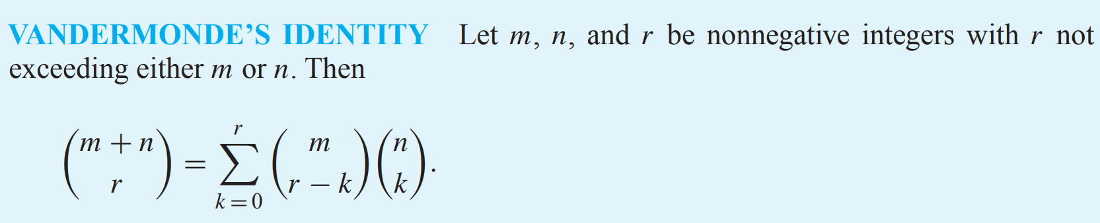
Other Identities Involving Binomial Coefficients
We conclude this section with combinatorial proofs of two of the many identities enjoyed by the binomial coefficients.
Remark: This identity was discovered by mathematician Alexandre-Théophile Vandermonde in the eighteenth century.
FREE: For Complete Playlist: https://www.youtube.com/c/FahadHussaintutorial/playlists
For Code, Slide and Books: https://fahadhussaincs.blogspot.com/

Slide 67
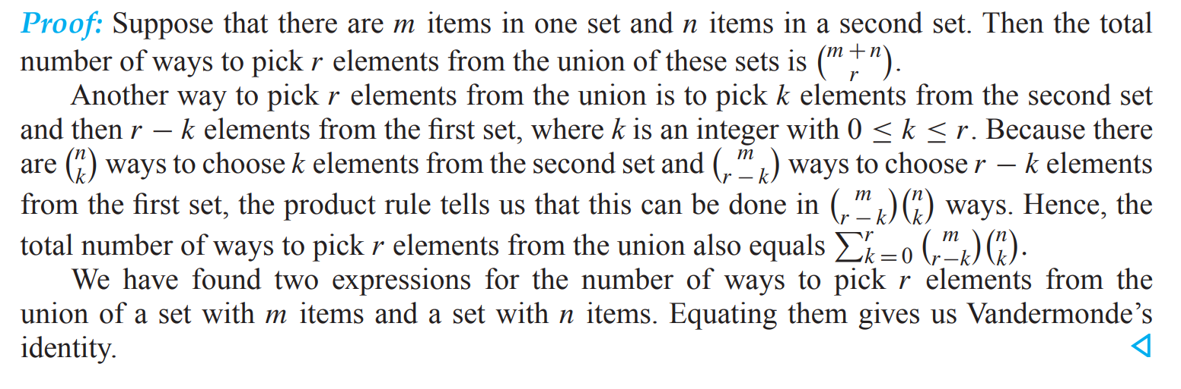
Other Identities Involving Binomial Coefficients
Corollary 4 follows from Vandermonde’s identity,
Lets understand this!
FREE: For Complete Playlist: https://www.youtube.com/c/FahadHussaintutorial/playlists
For Code, Slide and Books: https://fahadhussaincs.blogspot.com/

Slide 68
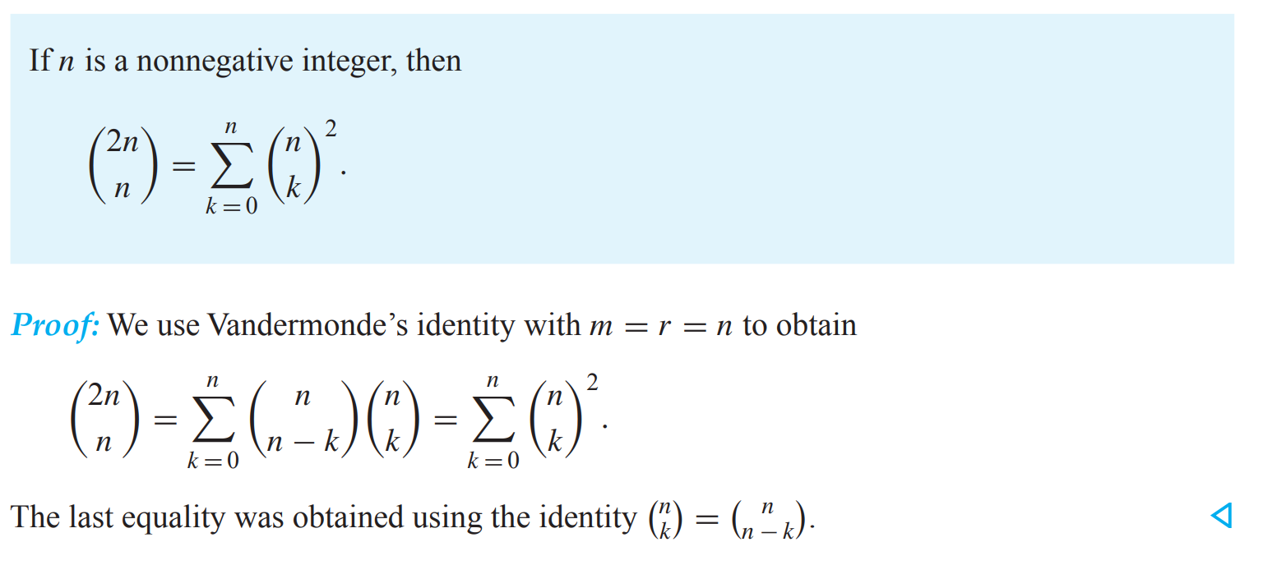
Other Identities Involving Binomial Coefficients
COROLLARY 4
FREE: For Complete Playlist: https://www.youtube.com/c/FahadHussaintutorial/playlists
For Code, Slide and Books: https://fahadhussaincs.blogspot.com/

Slide 69
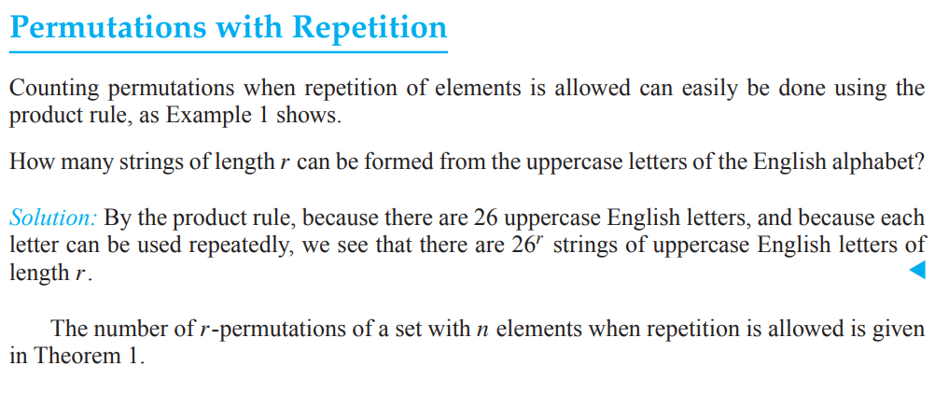
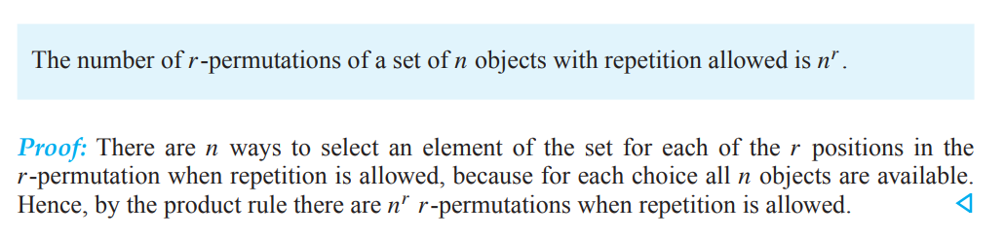
6.5 Generalized Permutations and Combinations
FREE: For Complete Playlist: https://www.youtube.com/c/FahadHussaintutorial/playlists
For Code, Slide and Books: https://fahadhussaincs.blogspot.com/

Slide 70
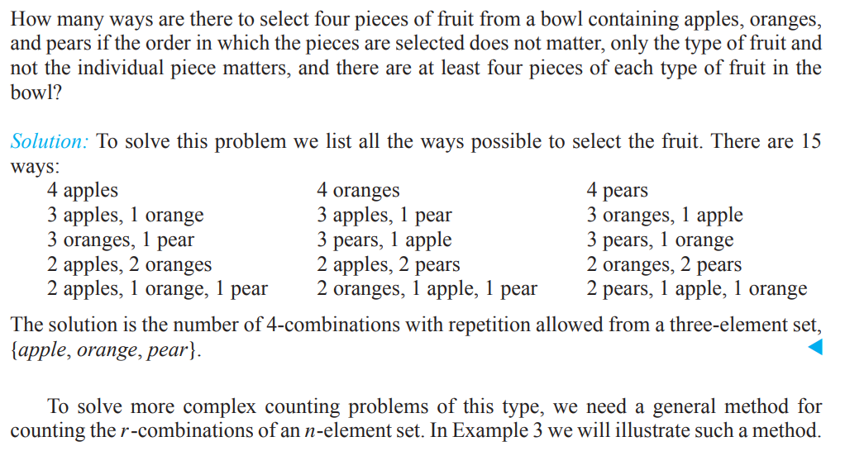
6.5 Generalized Permutations and Combinations
Combinations with Repetition
FREE: For Complete Playlist: https://www.youtube.com/c/FahadHussaintutorial/playlists
For Code, Slide and Books: https://fahadhussaincs.blogspot.com/

Slide 71


6.5 Generalized Permutations and Combinations
Combinations with Repetition
FREE: For Complete Playlist: https://www.youtube.com/c/FahadHussaintutorial/playlists
For Code, Slide and Books: https://fahadhussaincs.blogspot.com/

Slide 72

6.5 Generalized Permutations and Combinations
Combinations with Repetition
FREE: For Complete Playlist: https://www.youtube.com/c/FahadHussaintutorial/playlists
For Code, Slide and Books: https://fahadhussaincs.blogspot.com/

Slide 73

6.5 Generalized Permutations and Combinations
FREE: For Complete Playlist: https://www.youtube.com/c/FahadHussaintutorial/playlists
For Code, Slide and Books: https://fahadhussaincs.blogspot.com/

Slide 74

6.5 Generalized Permutations and Combinations
FREE: For Complete Playlist: https://www.youtube.com/c/FahadHussaintutorial/playlists
For Code, Slide and Books: https://fahadhussaincs.blogspot.com/

Slide 75


6.5 Generalized Permutations and Combinations
Permutations with Indistinguishable Objects
Some elements may be indistinguishable in counting problems. When this is the case, care must be taken to avoid counting things more than once.
FREE: For Complete Playlist: https://www.youtube.com/c/FahadHussaintutorial/playlists
For Code, Slide and Books: https://fahadhussaincs.blogspot.com/

